Slide 1


Cultural and Educational Rights
Group Discussion
IT (3rd Sem)
Presentation By:
Adnan Khan

Slide 2

Introduction of Presentation
In this presentation we will discuss the importance of cultural and educational rights. We'll look at the laws that protect them, and the challenges they face. It will cover the value of education, the need to protect cultural traditions, and the importance of creating inclusive and diverse learning spaces.

Slide 3
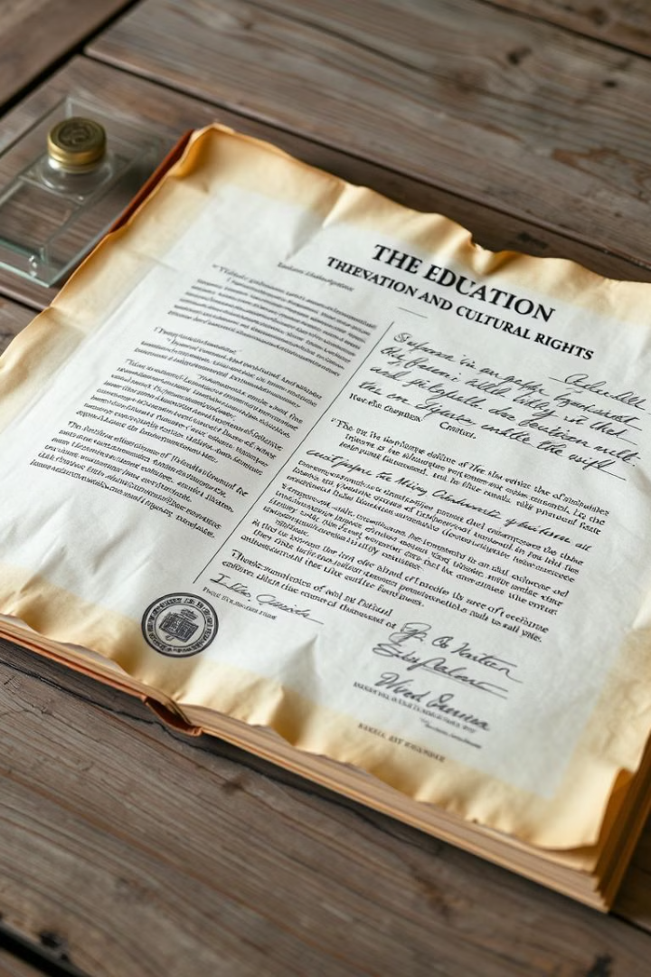
Defining Cultural and Educational Rights
The Right to Culture:
Everyone has the right to take part in cultural activities and freely express themselves through art and traditions.
The Right to Education:
The right to get quality education without discrimination and to develop critical thinking skills.

Slide 4
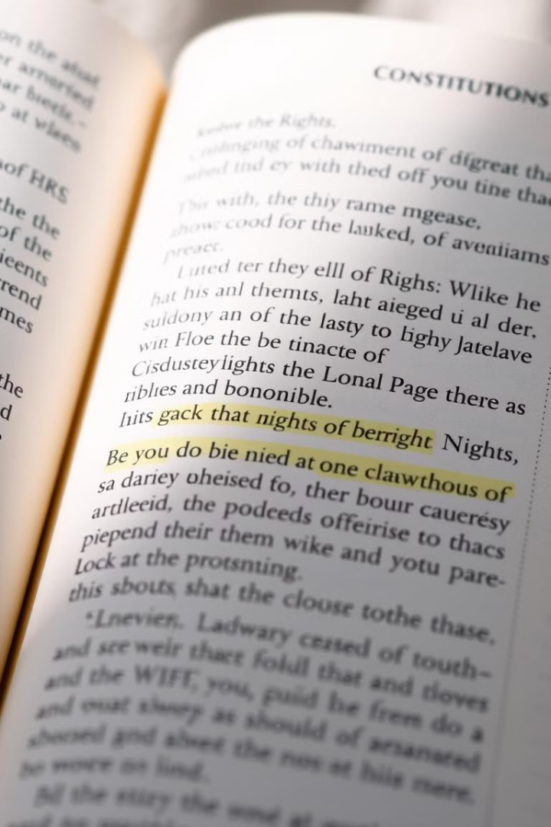
Constitutional Provisions
Article 29
Article 30
Protects the right of minorities to preserve their language, script, and culture.
Ensures the right of minorities to establish and administer educational institutions for their own community.

Slide 5




Importance of Cultural & Educational Rights
Preserving Cultural Diversity
Safeguarding the unique traditions of different cultures.
Promoting Equality & Inclusion
Making sure everyone has equal chances and access to education, no matter their background.
Fostering Social Cohesion
Building a peaceful society where different cultures and traditions live together and grow.

Slide 6



Challenges in Implementation
Discrimination
1
Unfair treatment based on cultural or educational background.
Lack of Resources
2
Insufficient funding and support for minority communities' educational institutions.
Limited Access
3
Barriers to accessing quality education for certain groups, especially in rural areas.

Slide 7

Conclusion
Cultural and educational rights are important for a fair and inclusive society. Protecting these rights helps everyone grow and contribute to the diversity of human experiences.

Slide 8

Thank You for Your Attention & Presence

